Slide 1
PIC-SURE
NIH Cloud Platform Interoperability
March 17th 2020
Arnaud Serret-Larmande, MD Msc
Avillach Lab, Department of Biomedical Informatics
Harvard Medical School

Slide 2
PIC-SURE overview

Slide 3
PIC-SURE overview
Part of the BioData Catalyst initiative
Studies and variables exploration tool + data retrieving

Slide 4
PIC-SURE overview
Clinical and genomic datasets integration from multiple TOPMed and TOPMed related studies
Two components: Graphical User Interface and API
Graphical User Interface: Allows investigator to search available data and conduct feasibility queries, allowing for cohorts to be built in real-time and results to be exported
Cohort building and analysis directly through the PIC-SURE API.

Slide 5
PIC-SURE components

Slide 6
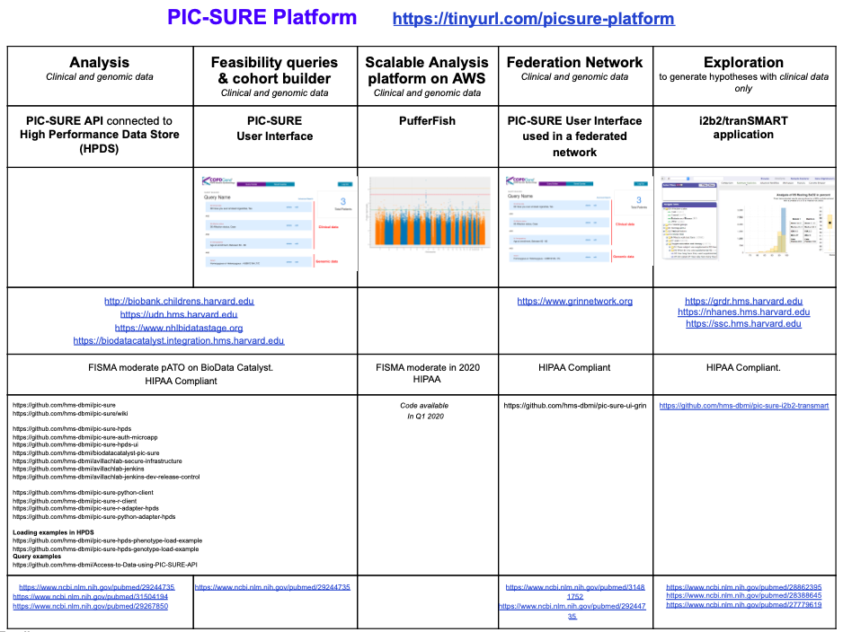
Active Funding:
NHGRI U54HG007963 PATIENT-CENTERED INFORMATION COMMONS
NHLBI BioData Catalyst 3OT3HL142480
THE INTEGRATION OF TOPMED AND OTHER HEART, LUNG, BLOOD AND SLEEP (HLBS) DATA SETS WITH THE DATA COMMONS
NHLBI CureSC 3OT3HL142480-S1
NHGRI UDN U01HG007530 COORDINATING CENTER FOR THE UNDIAGNOSED DISEASE NETWORK PHASE II
NCATS U01TR002623 INSTRUMENTING THE DELIVERY SYSTEM FOR A GENOMICS RESEARCH INFORMATION COMMONS
NICHD U01HL121518 DATA FUSION: A SUSTAINABLE, SCALABLE, OPEN SOURCE REGISTRY ADVANCING PVD RESEARCH

Slide 7
Platform components
Graphical User Interface:
Access phenotypic variables (and soon genomic ones)
Search all phenotypic data by typing terms directly in the search bar, across all available studies
Search available harmonized variables across multiple studies
Develop and refine cohorts in real-time by building complex queries using multiple variables
Refine queries and subset cohort based on variable values
Export full phenotypic datasets to analysis environment with the click of a button
R and Python API
Explore studies and variables
Query data directly from the API
Learn how to use the API through public example Jupyter notebooks, available on GitHub and cloud computing platforms (Seven Bridges and Terra)
Save query identifiers to easily locate past queries in the future

Slide 8
PIC-SURE specificity
Under appropriate governance, can allow users to search aggregate data and see what variables and cohorts are available prior to creating an account or officially requesting data
Develop and refine their cohort using clinical (and soon genomic) data
Direct access to harmonized variables
Data download from Graphical User Interface, or data query from the API
Easy access to the data of interest: for example, the whole Framingham Heart Study can be retrieved in one tabular format
PIC-SURE API in two languages (R and python) and works from multiple cloud-computing platforms using Jupyter notebooks or RStudio Server.

Slide 9
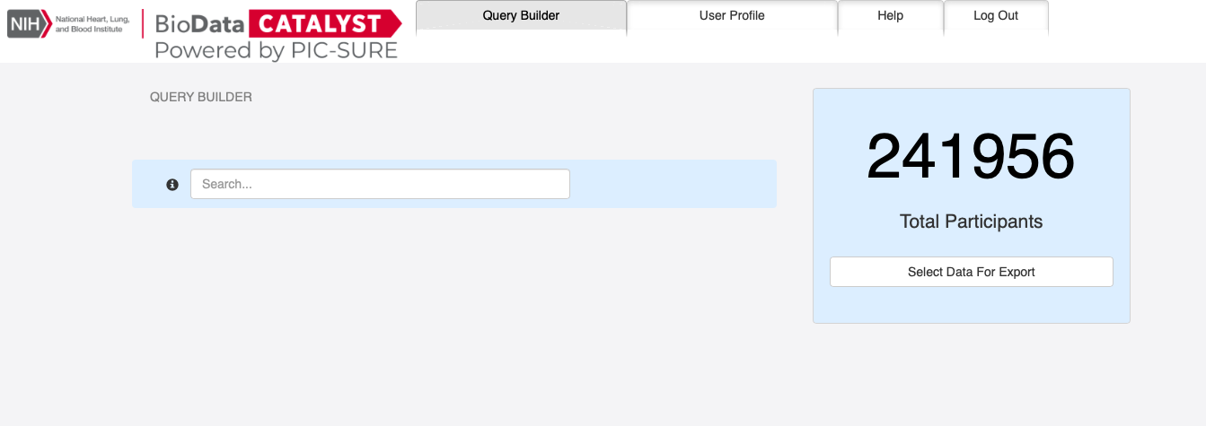
User Interface
https://picsure.biodatacatalyst.nhlbi.nih.gov/
Controlled access, login via eRA Commons

Slide 10
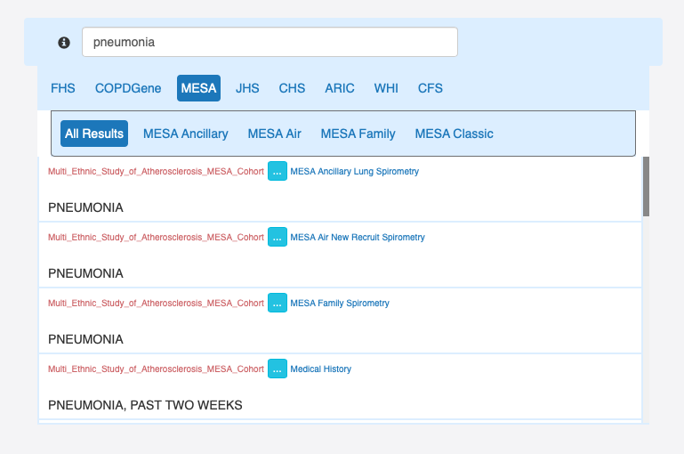
User Interface
Variables from 29 studies
241,956 patients
43 harmonized variables
Variable selection through search engine

Slide 11
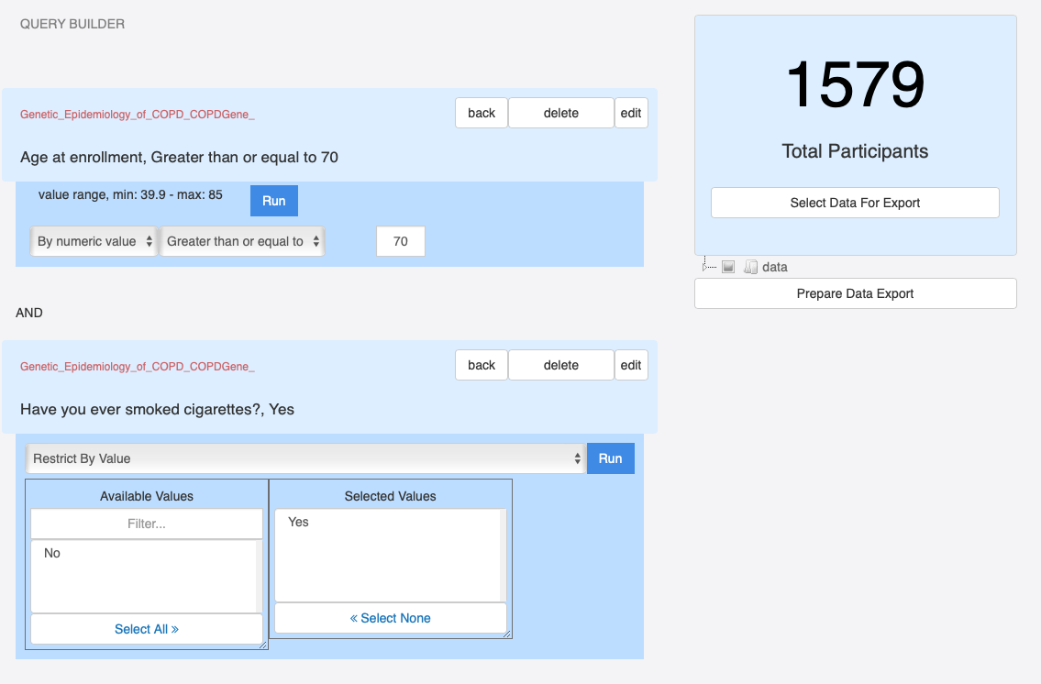
User Interface
Study feasibility through cross-counts using variable values
Possible data export after cohort constitution

Slide 12


PIC-SURE API
Available in two languages: R and python
Access data using cloud environments
  Authentication through user specific token
  Remote access, no need to download data locally
Enable to access 20+ different studies through the same API

Slide 13
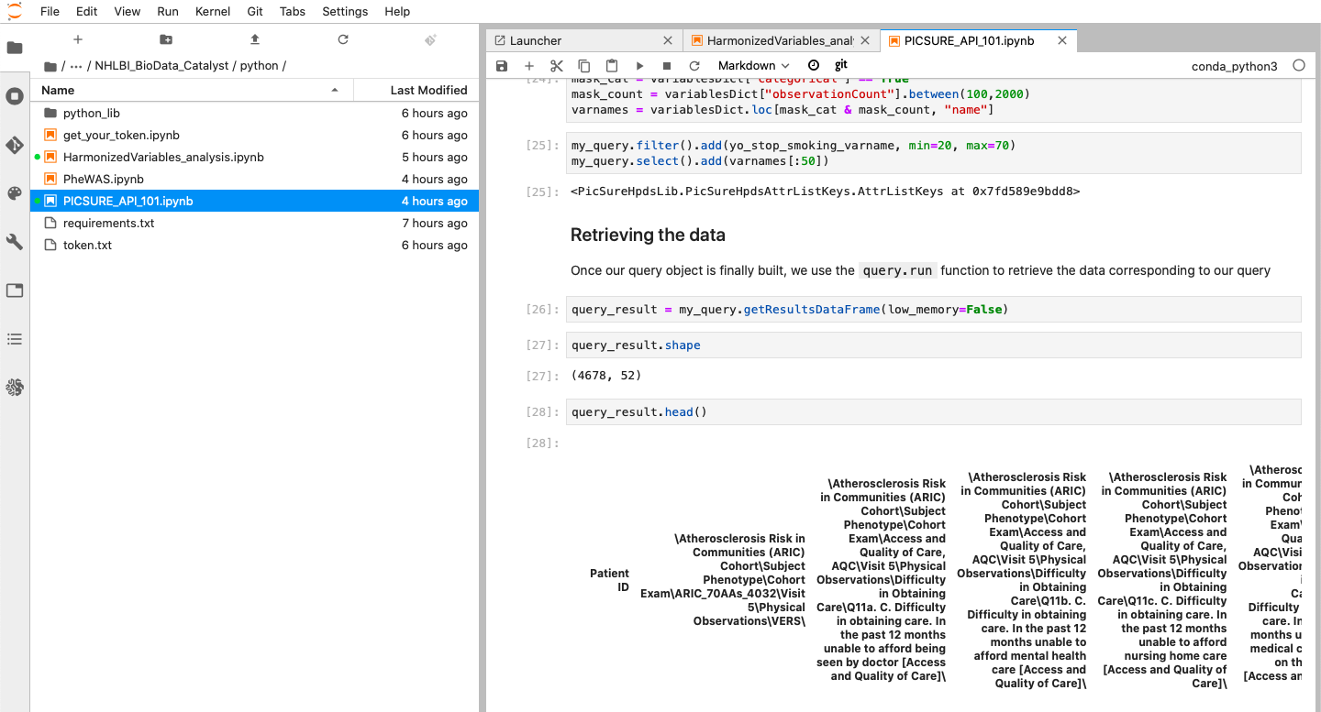
PIC-SURE API
Three different example notebooks publicly available in both R and python:
PIC-SURE 101
Phenome-Wide analysis example
Harmonized variables analysis examples
GitHub repo: https://github.com/hms-dbmi/Access-to-Data-using-PIC-SURE-API/tree/master/NHLBI_BioData_Catalyst

Slide 14


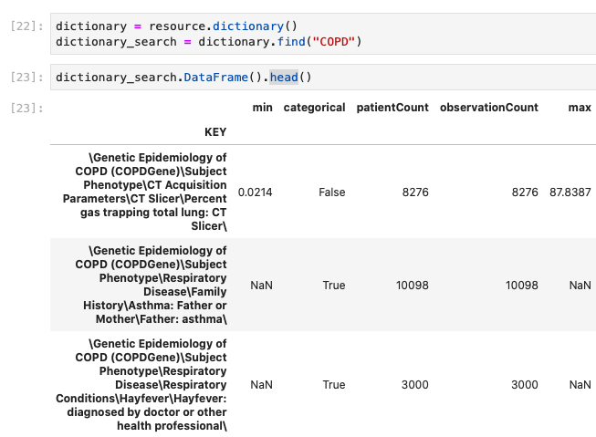
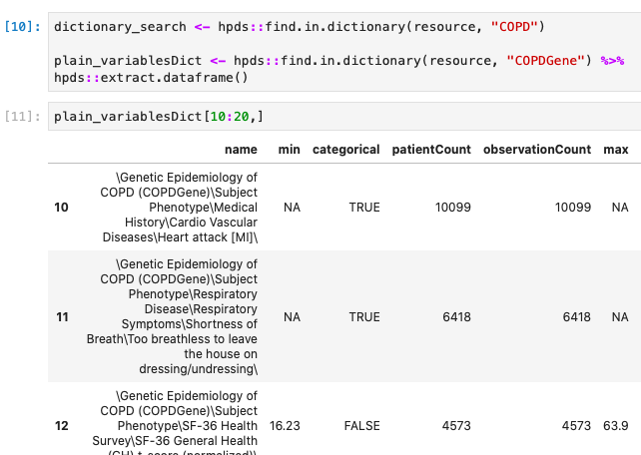
PIC-SURE API: Cross studies variables information

Slide 15
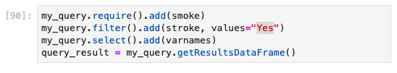
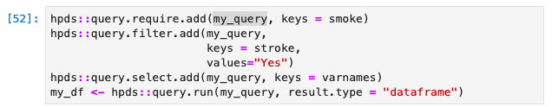
PIC-SURE API: Data querying

Slide 16
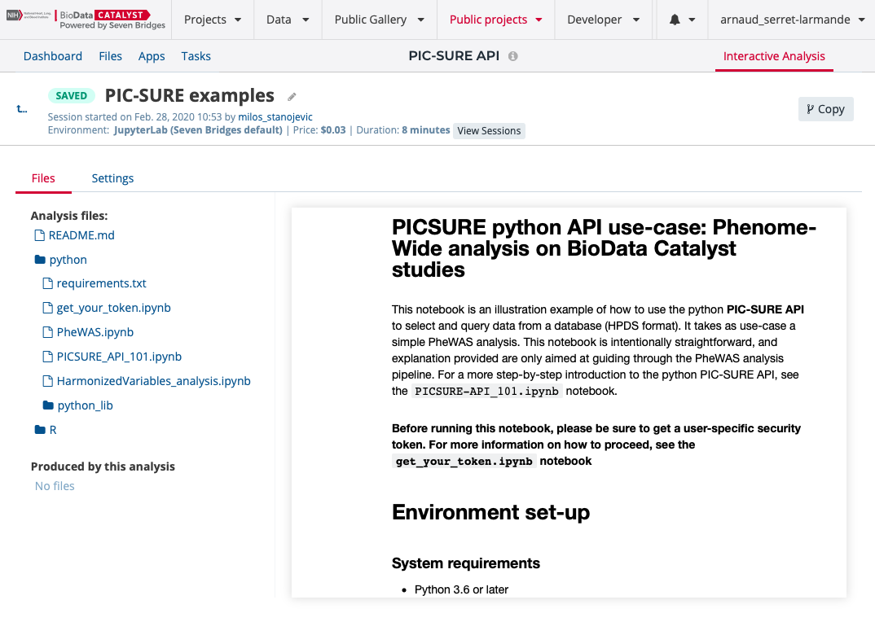
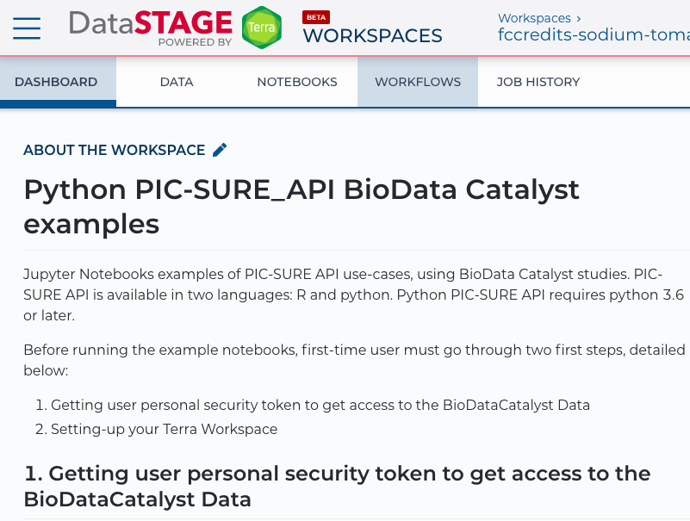
Publicly available Workspaces
Seven Bridges
Terra (available soon)

Slide 17
Policy

Slide 18
Policy
Use of BioData Catalyst policies:
Currently, a user can perform search with authentication only (no authorization) and get back aggregate counts for phenotypic study variables.
  Counts resulting in less than 10 will be displayed as <10 (for example, a query resulting in 5 participants will be displayed as less than 10)
  Counts resulting in zero will be displayed as 0
  Stigmatizing variable search not allowed
No genomic data search without authorization
Direct download of certain types of data are not allowed

Slide 19
PIC-SURE
Links:
BioData Catalyst front-page
PIC-SURE User Interface
GitHub public repo: Jupyter and RMarkdown notebooks example
Seven Bridges publicly available Workspaces

